Slide 1

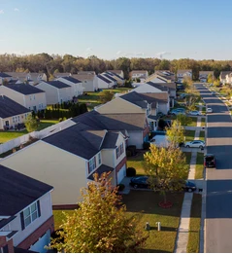
Understanding Migration Patterns in the United States after the Pandemic
COMPSCI 109A Final Project
Archita Misra, Noor Rahman, Sehar Noor, Shreya Chaturvedi and Shreya Dubey

Slide 2
COVID-19 led to remote work and migration out of cities
Observation
Implication
COVID-19 lockdown; Increase in remote work
Out-migration from cities
Re-distribute the population and economic activities in the US
Some factors that this decision can depend on:
Housing market trends
Demographic diversity
Educational facilities
COVID-19 preparedness

Slide 3
COVID-19 led to remote work and migration out of cities
Observation
Implication
COVID-19 lockdown; Increase in remote work
Out-migration from cities
Re-distribute the population and economic activities in the US
Problem Statement: What factors are most predictive of county-level migration patterns after COVID-19 in the United States?

Slide 4


We answer this question using two main datasets; our unit of analysis is counties
IRS Statistics of Income Tax Migration Data
Socio-economic data compiled by Kaggle in 2019 and 2021
Data description: contains migration flows into (and out of) the destination state and county in year one from the origin state and county in year two.
Data description: integrates various aspects such as weather conditions, health statistics, hospital information, and COVID-19 data specifically for U.S. counties.
Response variable
Share of outflows (outflows divided by county population)
Total counties
3,143 Counties across the United States

Slide 5
Exploratory Data Analysis
To explore the relationship between out-migration from a county and other variables in our dataset

Slide 6
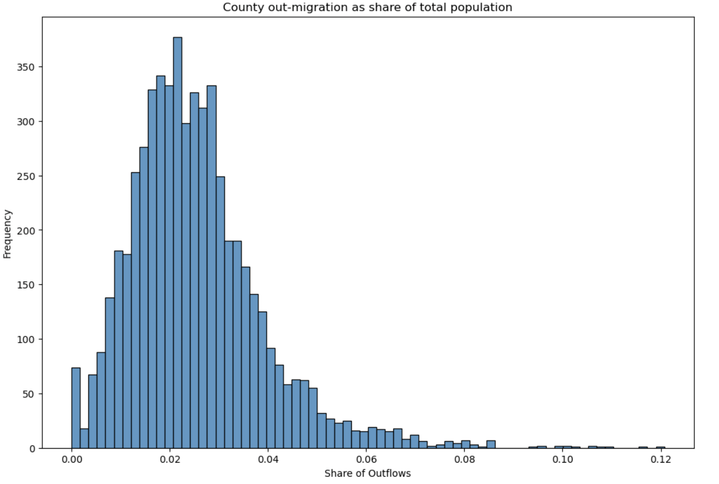
In most counties, the proportion of people moving out is relatively small compared to the total population.
These are counties with unusually high out-migration shares, significantly different from most other counties.

Slide 7
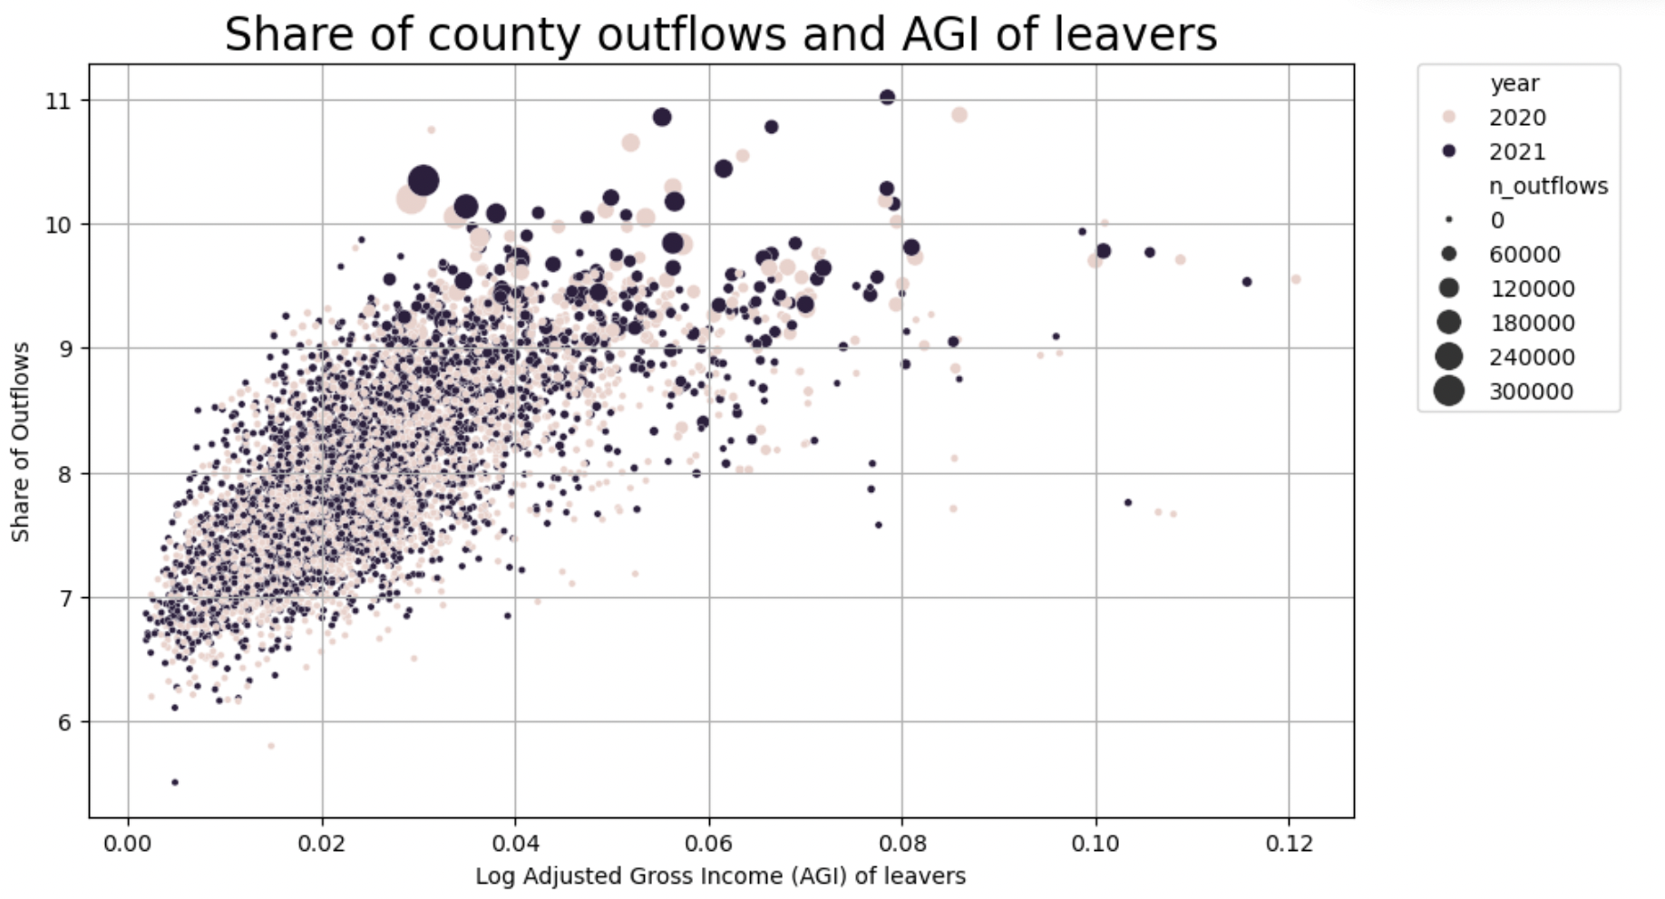
There is a positive correlation between log of AGI of leavers and the share of outflows. This indicates that the financial status of leavers while not the sole factor influencing the share of outflows, may still be important.
There are outliers in the data, particularly noticeable in counties with either very high or very low log AGI of leavers. These outliers might represent unique situations in specific counties.

Slide 8
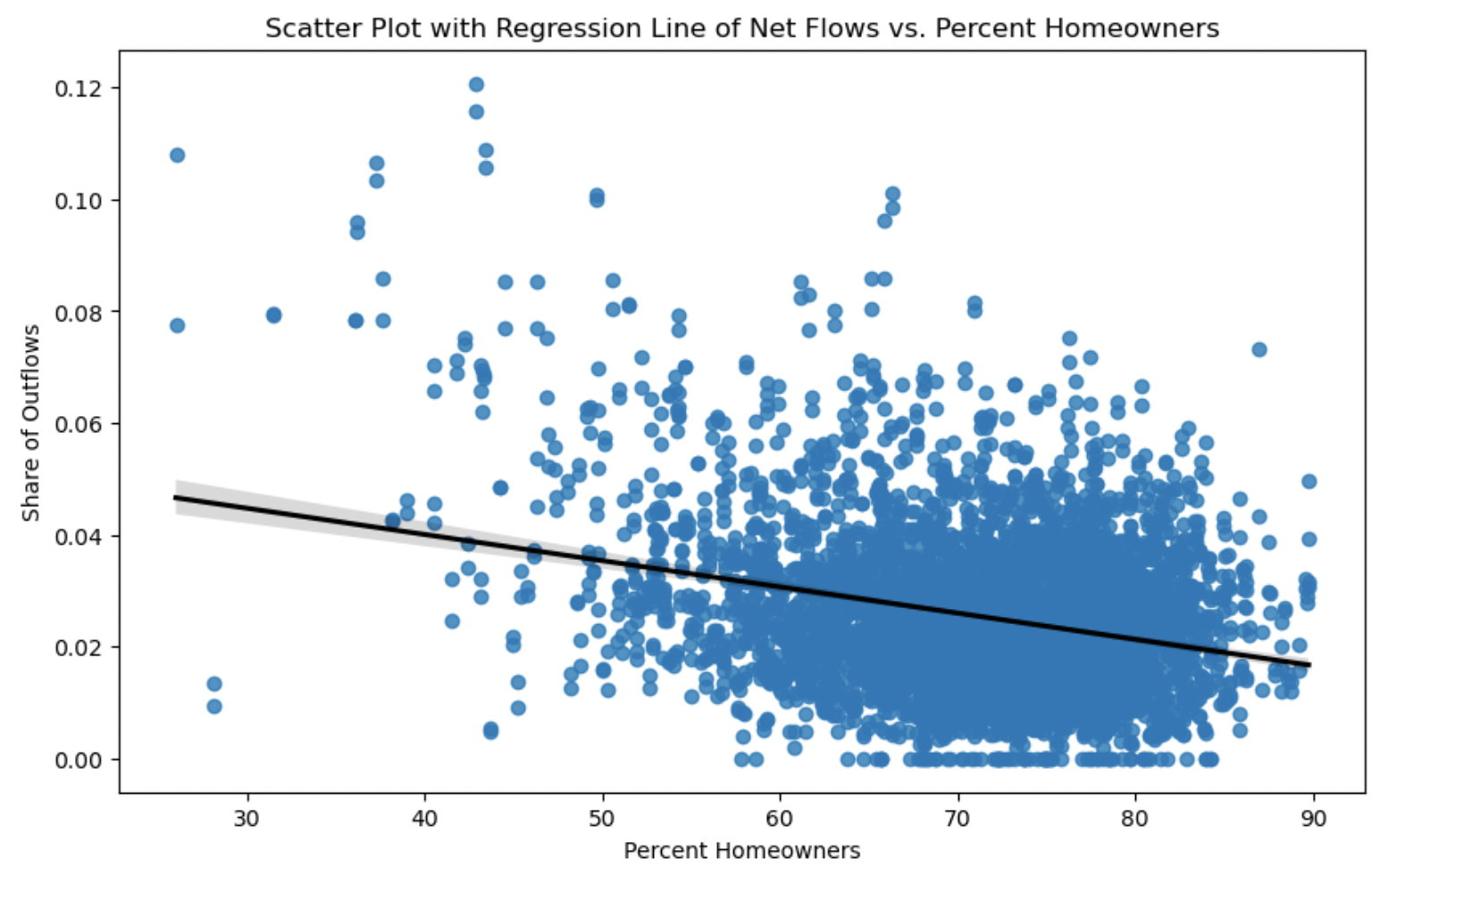
As the percentage of homeowners in a county increases, the share of outflows might decrease slightly.
Counties with both lower and higher percentages of homeownership show a range of outflow shares, suggesting that homeownership is one of several factors influencing migration patterns.

Slide 9
Model Selection and Results

Slide 10
We trained 6 models to find the most imp predictors for share of outflows out of a county
Model 1
Kitchen Sink Regression
We split the dataset with 4,080 intro train and test using the 80:20 ratio
We used cross validation to tune the different hyper parameters for the models
We also added feature importance for different graphs to increase their interpretability
Model 2
Lasso Regression
Model 3
Decision Trees
Model 4
Bagging
Model 5
Boosting
Model 6
Random Forest

Slide 11
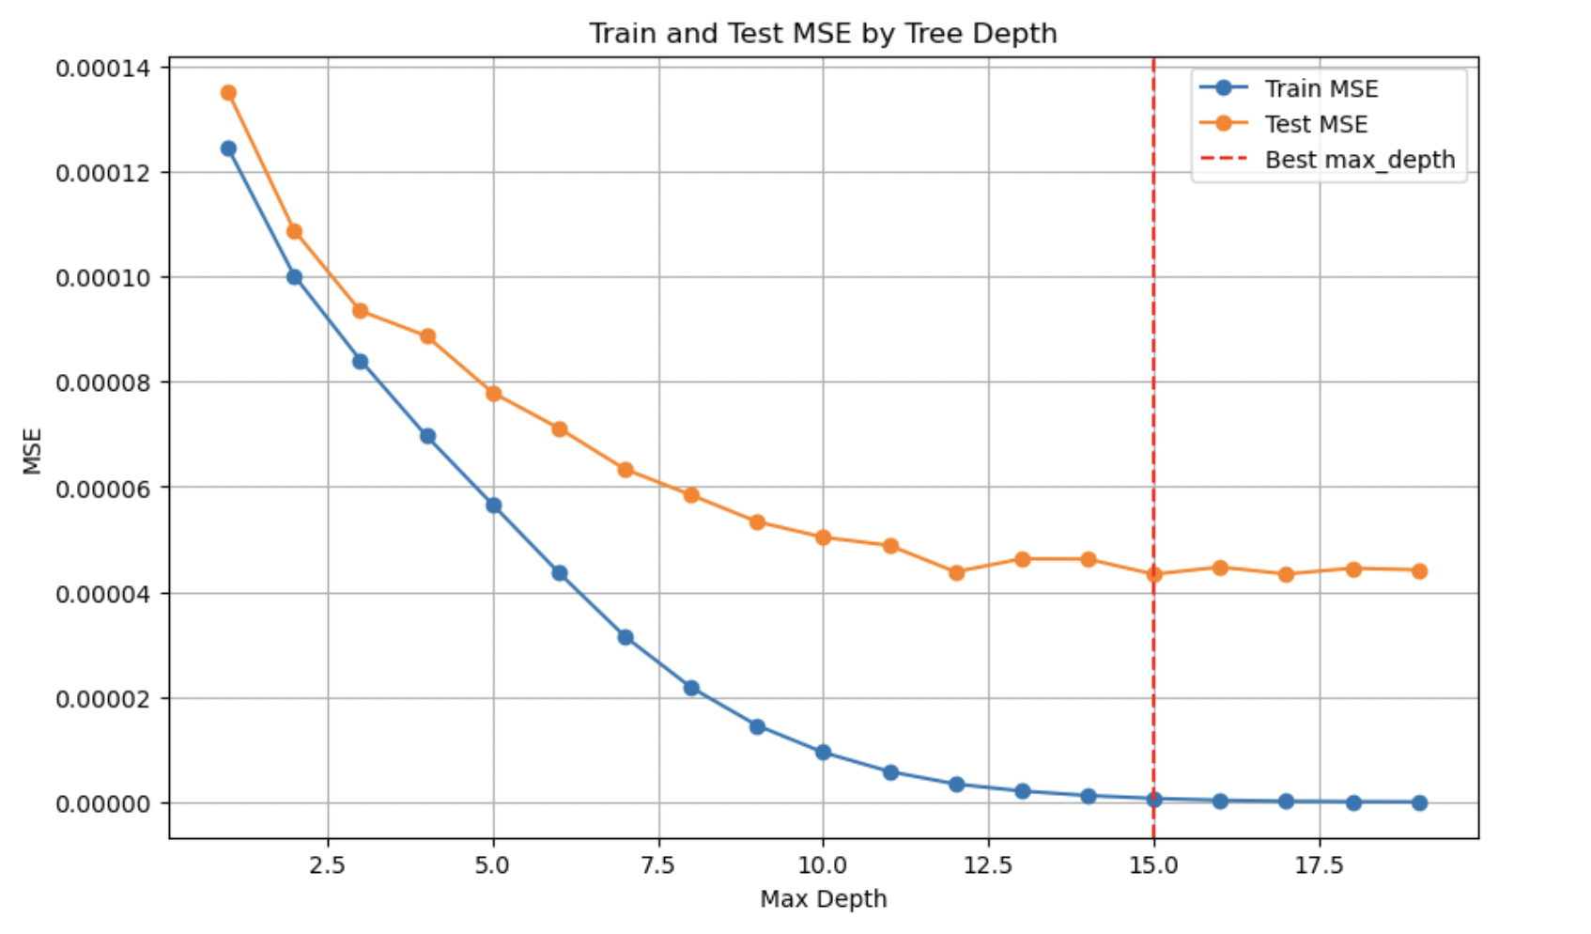
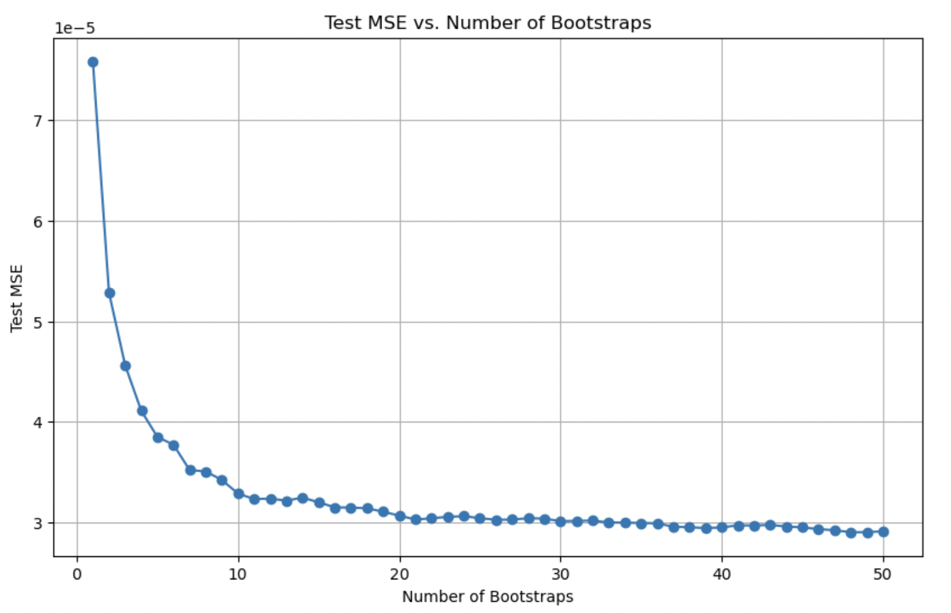
For Decision Trees, used CV to find the best maximum depth
For Bagging, used CV to find the best number of bootstraps
For Boosting, used grid search to find the best learning rate
For Random Forest, used grid search to find the best number of estimators and maximum depth

Slide 12
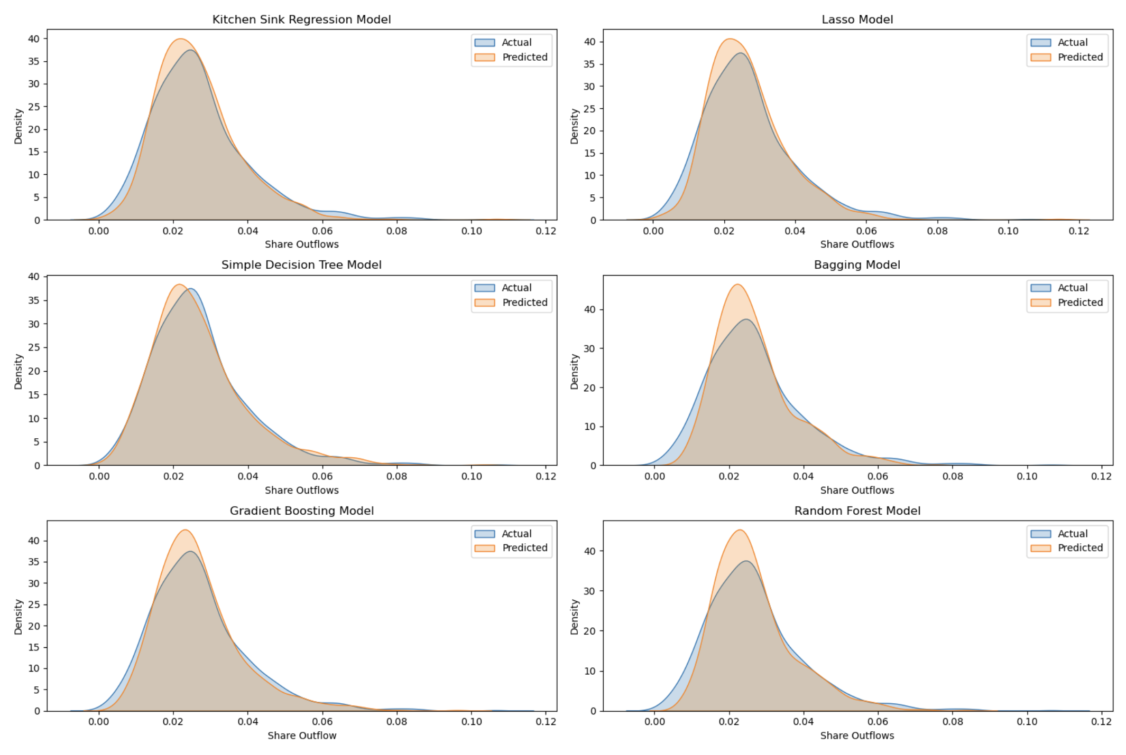
Our model predictions for the test data are as follows:

Slide 13
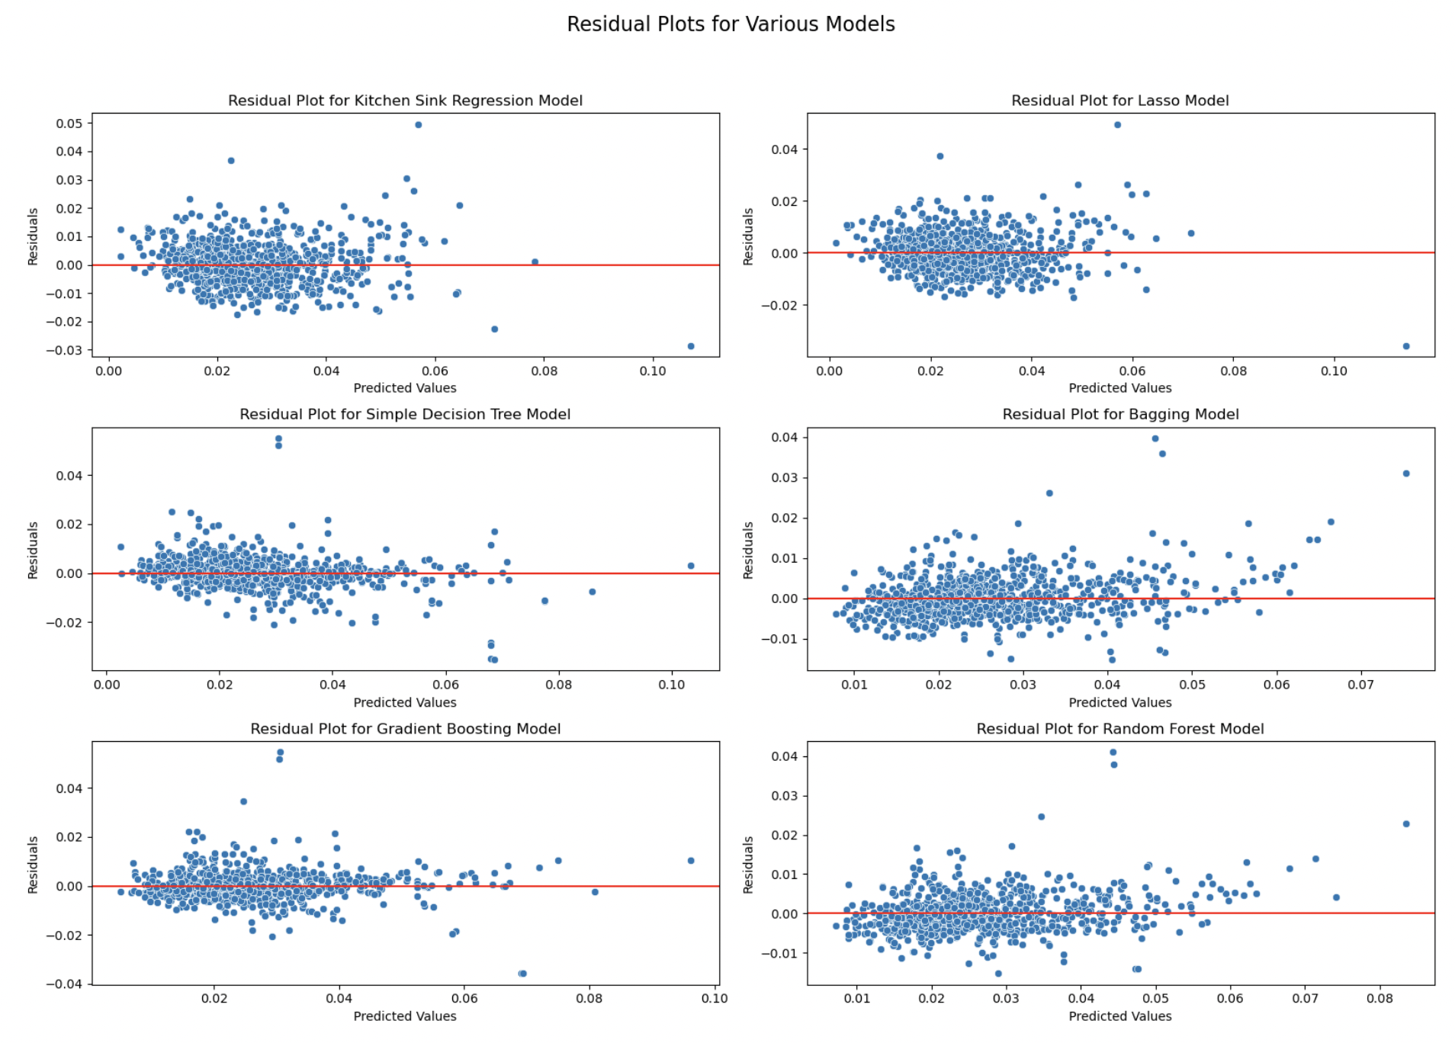
The residual plots for different models are as follows:

Slide 14
Random Forest has the lowest test MSE:
Model number | Model | Train MSE | Test MSE | R2
1 | Kitchen Sink | 4.508344e-05 | 0.000057 | 0.668169
2 | Lasso | 4.747376e-05 | 0.000057 | 0.667252
3 | Decision Trees | 6.658046e-07 | 0.000043 | 0.747337
4 | Bagging | 6.534427e-06 | 0.000029 | 0.830704
5 | Boosting | 1.224253e-06 | 0.000039 | 0.773877
6 | Random Forest | 3.368038e-06 | 0.000025 | 0.853828

Slide 15
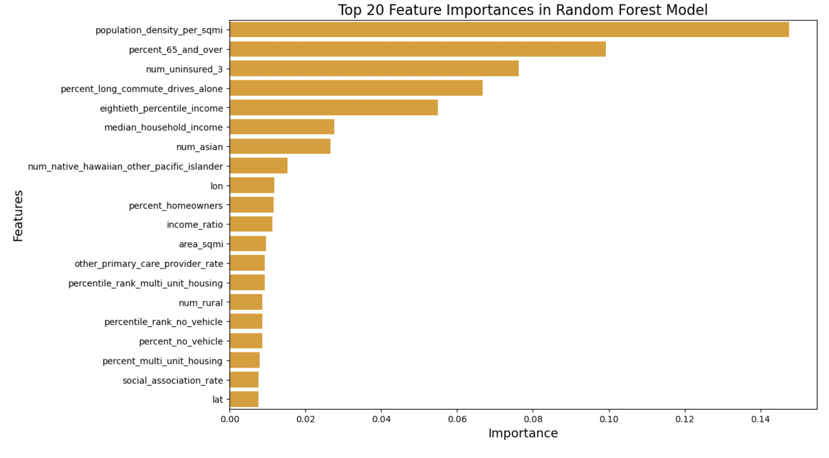
Population density per sq miles is the most important predictor for out migration

Slide 16




This predictive analysis can now be used for:
Creating effective, targeted economic or social policies in counties to support communities facing demographic changes
Preparing education and healthcare systems for changing populations
Influencing infrastructure development and environmental management strategies
Understanding changes in employment opportunities, that influence both local businesses and job seekers

Slide 17
Scope for Improvement

Slide 18


Our work in the future can include:
Recommendations for how our model can be implemented for better economic decision-making in areas that are predicted to have high out migration
Recommendations for how the model can be scaled to handle even more granular data (e.g., at the ZIP code level)
Recommendations for how the model can be expanded to data from more recent years such as 2022 or 2023 where the effects of the pandemic are less salient

